Slide 1
CSA0984-JAVA ASSIGNEMENT
1 Write a program to check the entered user name is valid or not. Get both the inputs from the user.Sample Input:Enter the user name: Saveetha@789Reenter the user name: Saveetha@123 Sample Output:User name is Invalid

Slide 2
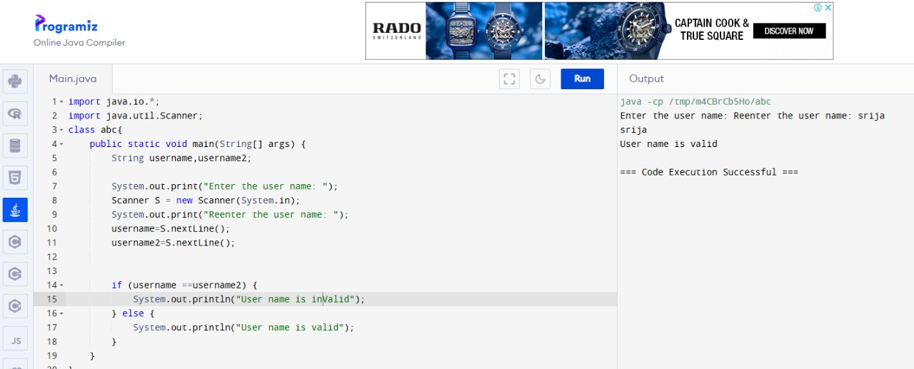

Slide 3
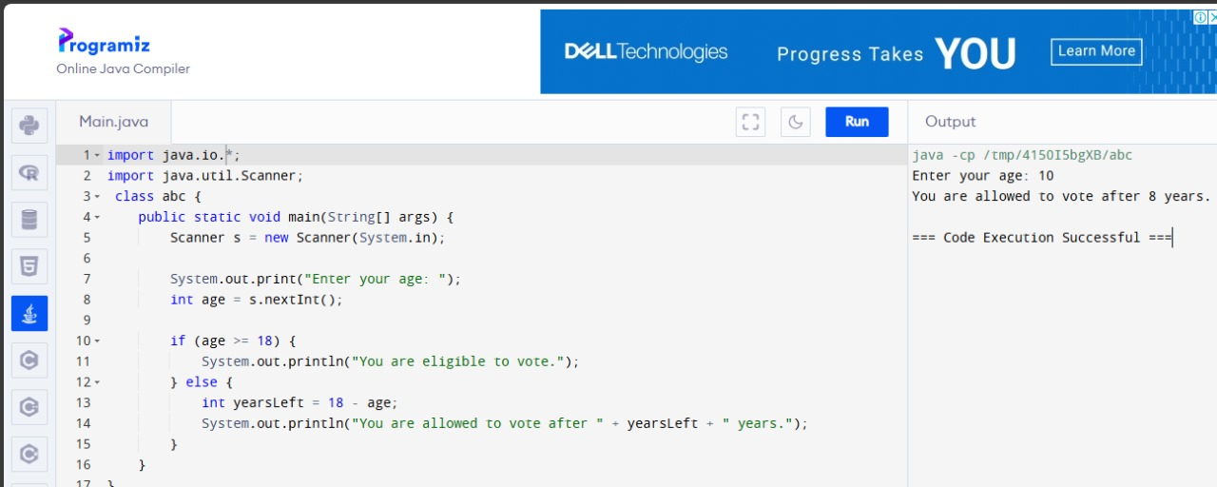
4. Write a program to find whether the person is eligible for vote or not. And if that particular person is not eligible, then print how many years are left to be eligible.Sample Input: Enter your age:7Sample output:You are allowed to vote after 11 years

Slide 4
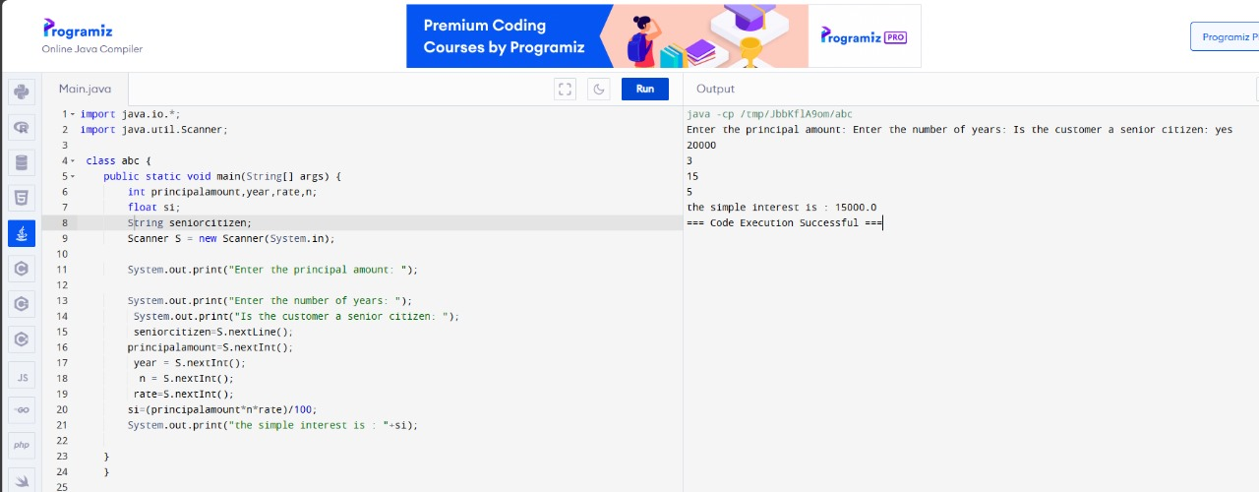
8.Write a program using function to calculate the simple interest. Suppose the customer is a senior citizen. He is being offered 12 percent rate of interest; for all other customers, the ROI is 10 percent.Sample Input:Enter the principal amount: 200000Enter the no of years: 3Is customer senior citizen (y/n): nSample Output:Interest: 60000

Slide 5
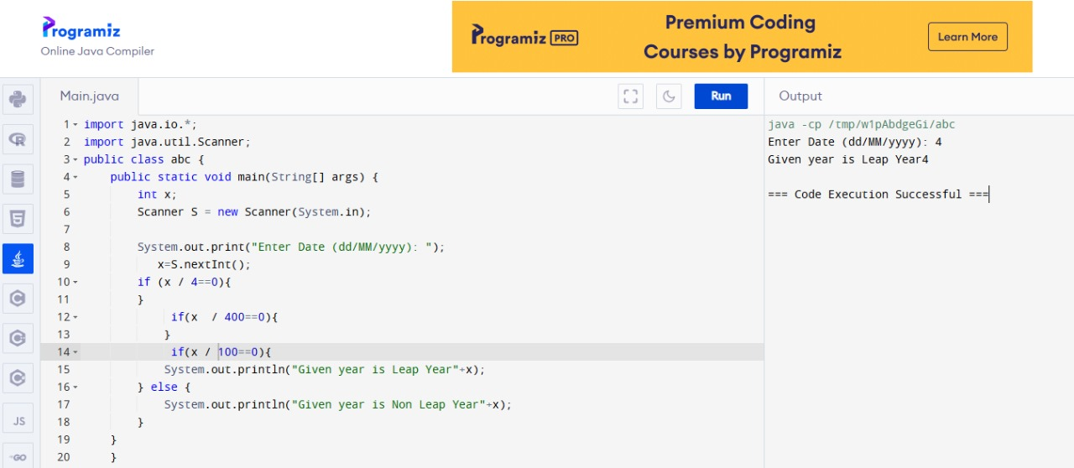
22. Find the year of the given date is leap year or notSample Input:Enter Date: 04/11/1947Sample Output:Given year is Non Leap Year

Slide 6
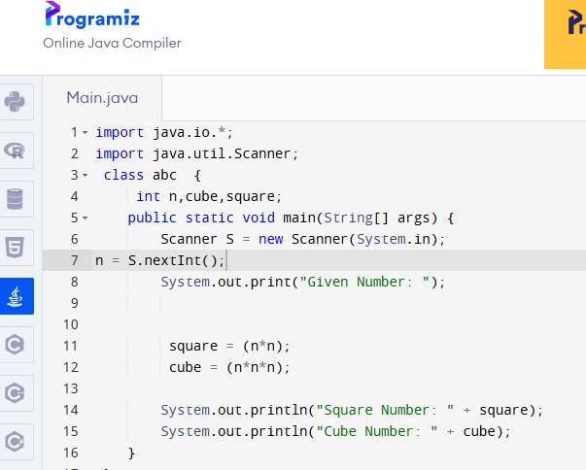
28. Write a program to find the square, cube of the given decimal numberSample Input:Given Number: 0.6Sample Output:Square Number: 0.36Cube Number:0.216

